Slide 1

“As THE FATHER HAS SENT ME…”
John 20:19-22

Slide 2
2014
Philippians 1:9-10 / The Love of Christ…
We must make the LOVE of Christ our CORE Competency.

Slide 3
2015
Hebrews 13:8-15 / The Glory of Christ…
We must make the GLORIFICATION of Christ our HIGHEST Priority.

Slide 4
2016
John 20:19-22 / The Mission of Christ…
We must make the Gospel of the MINISTRY of Christ our Sacred MISSION.

Slide 5
Romans 1:16 NKJV
For I am not ashamed of the gospel of Christ, for it is the power of God to salvation for everyone who believes...

Slide 6
Therefore…
We exist to do the MINISTRY of Christ; in the LOVE of Christ; for the GLORY of Christ!

Slide 7
John 20:19 NIV78
On the evening of that first day of the week, when the disciples were together, with the doors locked for fear of the Jews, Jesus came and stood among them and said, “Peace be with you!”

Slide 8
John 20:20 NIV78
After he said this, he showed them his hands and side. The disciples were overjoyed when they saw the Lord.

Slide 9
John 20:21-22 NIV78
Again Jesus said, “Peace be with you! As the Father has sent me, I am sending you.” ²² And with that he breathed on them and said, “Receive the Holy Spirit.”

Slide 10
John 20:21 NIV78
Again Jesus said, “Peace be with you! As the Father has sent me, I am sending you.”

Slide 11
“AS…”
Collins English Dictionary – 10th Edition
“To the same degree, amount, or extent; similarly; equally.”

Slide 12
1 Corinthians 6:19-20 WNT
And you are not your own, ²⁰ for you have been redeemed at infinite cost. Therefore glorify God in your bodies.

Slide 13
John 20:21 VOICE
“…In the same way the Father sent Me, I am now sending you.”

Slide 14
Legitimated By His RESURRECTION.

Slide 15
John 20:19 NIV78
On the evening of that first day of the week, when the disciples were together, with the doors locked for fear of the Jews, Jesus came and stood among them and said, “Peace be with you!”

Slide 16
John 20:20 NIV78
After he said this, he showed them his hands and side. The disciples were overjoyed when they saw the Lord.

Slide 17
1 Corinthians 15:2-3 NIV
By this gospel you are saved… ³ For what I received I passed on to you as of first importance: that Christ died for our sins according to the Scriptures,

Slide 18
1 Corinthians 15:4 NIV
That he was buried, that he was raised on the third day according to the Scriptures…

Slide 19
John 11:25 NIV
Jesus said…“I am the resurrection and the life…

Slide 20
John 14:6 AMP
Jesus said to him, “I am the [only] Way [to God] and the [real] Truth and the [real] Life; no one comes to the Father but through Me.”

Slide 21
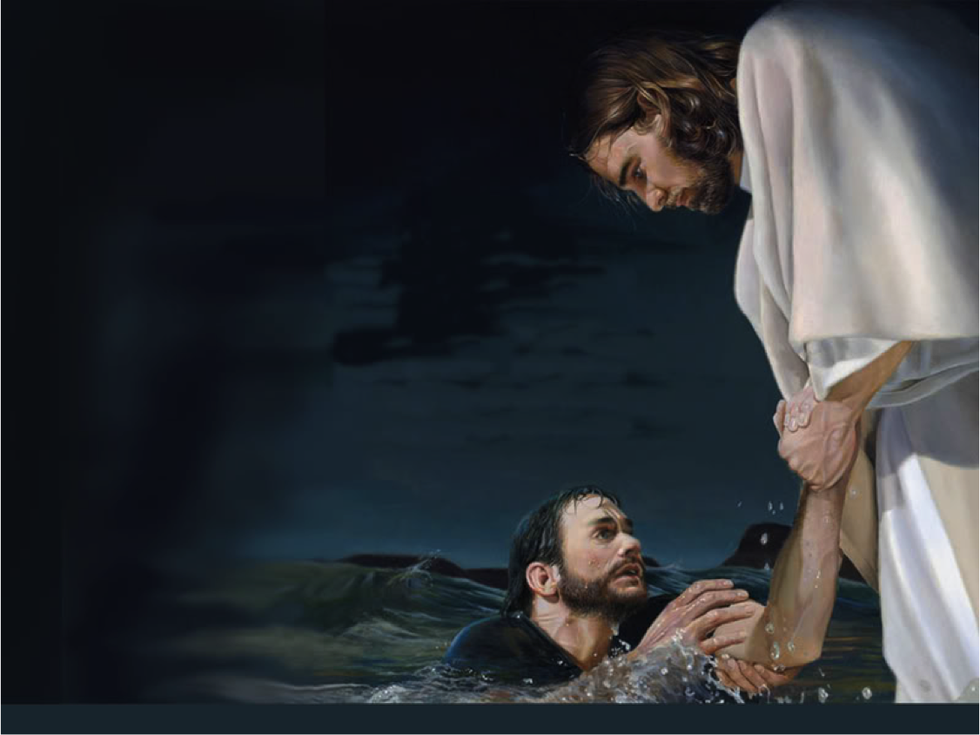
Motivated By His LOVE.

Slide 22
John 20:19 NIV78
On the evening of that first day of the week, when the disciples were together, with the doors locked for fear of the Jews, Jesus came and stood among them and said, “Peace be with you!”

Slide 23
John 3:16 KJV
For God so loved the world, that he gave his only begotten Son, that whosoever believeth in him should not perish, but have everlasting life.

Slide 24
The Great Love of Christ is…
INCARNATIONAL

Slide 25
John 14:18 NLT
“I will not abandon you as orphans—I will come to you.”

Slide 26
John 1:14 NIV
The Word became flesh and made his dwelling among us.

Slide 27
John 15:19 NIV84
“As the Father has loved me, so have I loved you.”

Slide 28
The Great Love of Christ is…
INCARNATIONAL
RELATIONAL

Slide 29
Mark 3:14-15 NIV84
He appointed twelve – designating them apostles – that they might be with him and that he might send them out to preach ¹⁵ and to have authority to drive out demons.

Slide 30
1 John 1:3 NLT
We proclaim to you what we ourselves have actually seen and heard so that you may have fellowship with us. And our fellowship is with the Father and with his Son, Jesus Christ.

Slide 31
1 John 1:4 NLT
We are writing these things so that you may fully share our joy.

Slide 32
John 13:34 NLT
“So now I am giving you a new commandment: Love each other. Just as I have loved you, you should love each other.”

Slide 33
John 13:35 NLT
“Your love for one another will prove to the world that you are my disciples.”

Slide 34
The Great Love of Christ is…
INCARNATIONAL
RELATIONAL
TRANSFORMATIONAL

Slide 35
John 15:13-14 NIV84
“Greater love has no one than this, that he lay down his life for his friends. ¹⁴ You are my friends…”

Slide 36
John 15:12 AMP
“This is My commandment, that you love and unselfishly seek the best for one another, just as I have loved you.”

Slide 37
John 15:13 AMP
“No one has greater love [nor stronger commitment] than to lay down his own life for his friends.”

Slide 38
Jeremiah 31:33 AMP
“…This is the covenant which I will make…” says the Lord, “I will put My law within them, and I will write it on their hearts; and I will be their God, and they will be My people.

Slide 39
Jeremiah 31:34a AMP
“And each man will no longer teach his neighbor and his brother, saying, ‘Know the Lord,’ for they will all know Me [through personal experience]…”

Slide 40
Jeremiah 31:34b AMP
“…From the least of them to the greatest,” says the Lord. “For I will forgive their wickedness, and I will no longer remember their sin.”

Slide 41
1 Corinthians 12:31 AMP
And yet I will show you a still more excellent way [one of the choicest graces and the highest of them all: unselfish love].

Slide 42
Ephesians 5:1 MESSAGE
Watch what God does, and then you do it, like children who learn proper behavior from their parents.

Slide 43
Ephesians 5:2a MESSAGE
Mostly what God does is love you. Keep company with him and learn a life of love. Observe how Christ loved us. His love was not cautious but extravagant…

Slide 44
Ephesians 5:2b MESSAGE
…He didn’t love in order to get something from us but to give everything of himself to us. Love like that.

Slide 45
1 John 4:19 NIV
We love because he first loved us.

Slide 46
Philippians 1:9 NLT
I pray that your love will overflow more and more, and that you will keep on growing in knowledge and understanding.

Slide 47
Philippians 1:10 NLT
For I want you to understand what really matters, so that you may live pure and blameless lives until the day of Christ’s return.

Slide 48
1 Peter 4:8 NLT
Most important of all, continue to show deep love for each other, for love covers a multitude of sins.

Slide 49
Ephesians 3:17-18 MESSAGE
And I ask him that with both feet planted firmly on love, ¹⁸ you'll be able to take in with all followers of Jesus the extravagant dimensions of Christ's love.

Slide 50
Ephesians 3:19 MESSAGE
Reach out and experience the breadth! Test its length! Plumb the depths! Rise to the heights! Live full lives, full in the fullness of God!

Slide 51
Captivated By His PEACE.

Slide 52
John 20:19 NIV78
On the evening of that first day of the week, when the disciples were together, with the doors locked for fear of the Jews, Jesus came and stood among them and said, “Peace be with you!”

Slide 53
John 20:21 NIV78
Again Jesus said, “Peace be with you! As the Father has sent me, I am sending you.”

Slide 54
Hebrews 13:8 AMP
Jesus Christ (the Messiah) is [always] the same, yesterday, today, [yes] and forever (to the ages).

Slide 55
John 14:1-2 NKJV
“Let not your heart be troubled; you believe in God, believe also in Me. ² In My Father’s house are many mansions; if it were not so, I would have told you. I go to prepare a place for you.”

Slide 56
John 14:3 NKJV
“And if I go and prepare a place for you, I will come again and receive you to Myself; that where I am, there you may be also.”

Slide 57
1 Peter 5:7 AMP
Casting the whole of your care [all your anxieties, all your worries, all your concerns, once and for all] on Him, for He cares for you affectionately and cares about you watchfully.

Slide 58
Isaiah 9:6 NKJV
For unto us a Child is born, Unto us a Son is given; And the government will be upon His shoulder. And His name will be called Wonderful, Counselor, Mighty God, Everlasting Father, Prince of Peace.

Slide 59
Matthew 5:9 NIV
Blessed are the peacemakers, for they will be called children of God.

Slide 60
Peace is Our…

Slide 61
Peace is Our…
INHERITANCE

Slide 62
Isaiah 53:5 NIV
But he was pierced for our transgressions, he was crushed for our iniquities; the punishment that brought us peace was upon him, and by his wounds we are healed.

Slide 63
John 14:27 NIV
Peace I leave with you; my peace I give you. I do not give to you as the world gives. Do not let your hearts be troubled and do not be afraid.

Slide 64
Ephesians 2:14 NCV
Christ himself is our peace…

Slide 65
Isaiah 26:3 NKJV
You will keep him in perfect peace, Whose mind is stayed on You, Because he trusts in You.

Slide 66
Philippians 4:6 NKJV
Be anxious for nothing, but in everything by prayer and supplication, with thanksgiving, let your requests be made known to God;

Slide 67
Philippians 4:7 NKJV
And the peace of God, which surpasses all understanding, will guard your hearts and minds through Christ Jesus.

Slide 68
Isaiah 32:17 NIV
The fruit of righteousness will be peace; the effect of righteousness will be quietness and confidence forever.

Slide 69
Peace is Our…
INHERITANCE
RESPONSIBILITY

Slide 70
Matthew 5:9 NIV78
Blessed are the peacemakers, for they will be called sons of God.

Slide 71
1 Peter 3:8 NIV
Finally, all of you, live in harmony with one another; be sympathetic, love as brothers, be compassionate and humble.

Slide 72
1 Peter 3:9 NIV
Do not repay evil with evil or insult with insult, but with blessing, because to this you were called so that you may inherit a blessing.

Slide 73
2 Timothy 2:24 NLT
The Lord’s servants must not quarrel but must be kind to everyone. They must be able to teach effectively and be patient with difficult people.

Slide 74
2 Corinthians 5:18 NIV
All this is from God, who reconciled us to himself through Christ and gave us the ministry of reconciliation:

Slide 75
2 Corinthians 5:19 NIV
That God was reconciling the world to himself in Christ, not counting men’s sins against them. And he has committed to us the message of reconciliation.

Slide 76
Romans 10:15 NKJV
And how shall they preach unless they are sent? As it is written: “How beautiful are the feet of those who preach the gospel of peace, Who bring glad tidings of good things!”

Slide 77
Peace is Our…
INHERITANCE
RESPONSIBILITY
LEGACY

Slide 78
James 3:18 NIV
Peacemakers who sow in peace raise a harvest of righteousness.

Slide 79
Luke 6:35 NIV
But love your enemies, do good to them, and lend to them without expecting to get anything back. Then your reward will be great, and you will be sons of the Most High, because he is kind to the ungrateful and wicked.

Slide 80
Harper’s Bible Dictionary…
“The Peacemakers are those who work for the wholeness and well-being that God wills for a broken world.”

Slide 81
Ephesians 2:14 NIV
For He Himself is our Peace…

Slide 82
Ephesians 2:14 VOICE
He is the embodiment of our peace, sent once and for all to take down the great barrier of hatred and hostility that has divided us so that we can be one.

Slide 83
Matthew 5:9 AMPC
Blessed (enjoying enviable happiness, spiritually prosperous—with life-joy and satisfaction in God’s favor and salvation, regardless of their outward conditions) are the makers and maintainers of peace, for they shall be called the sons of God!

Slide 84
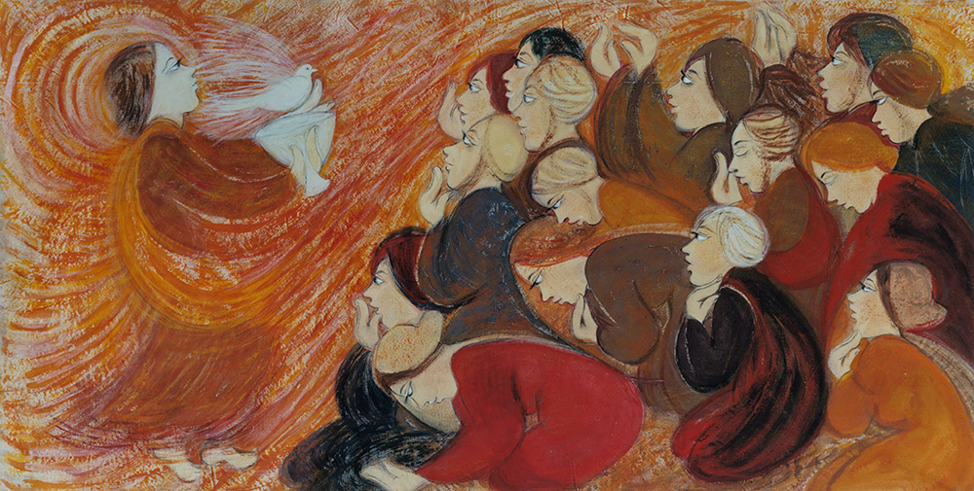
Empowered By His BREATH.

Slide 85
John 20:21-22 NIV78
Again Jesus said, “Peace be with you! As the Father has sent me, I am sending you.” ²² And with that he breathed on them and said, “Receive the Holy Spirit.”

