Slide 1
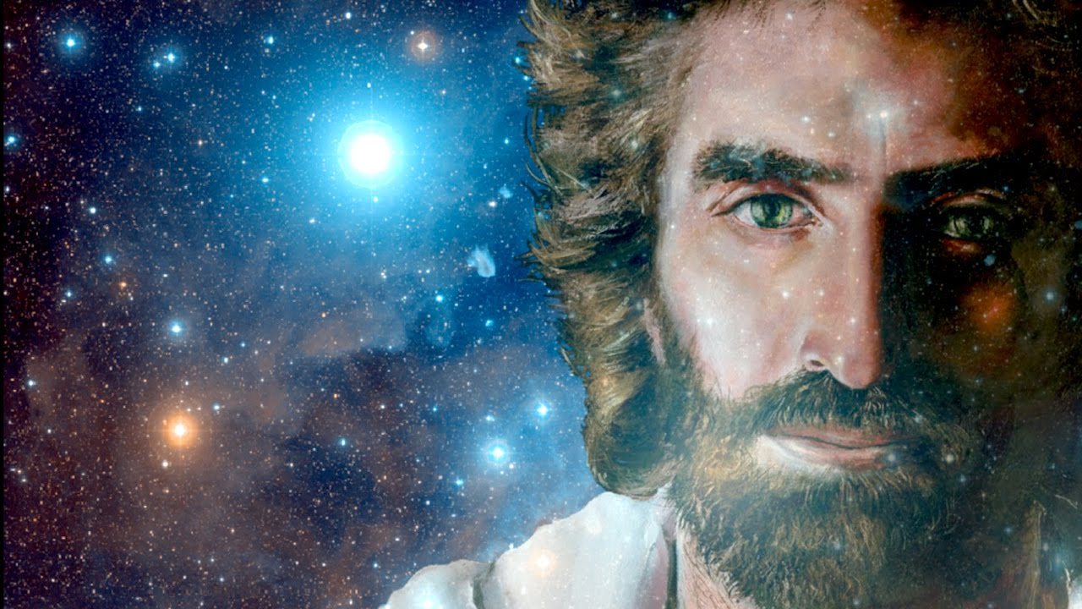
“…Peace Be With You”
John 20:19-22

Slide 2
In 2014…
We must make the LOVE of Christ our CORE Competency.

Slide 3
In 2015…
We must make the GLORIFICATION of Christ our Highest PRIORITY.

Slide 4
In 2016…
We must make the Gospel of the MINISTRY of Christ our Sacred MISSION.

Slide 5
In 2017…
We need the WITNESS of The Spirit of Christ and the FLOW of His Grace.

Slide 6
Acts 1:8 NIV
“But you will receive power when the Holy Spirit comes on you; and you will be my witnesses in Jerusalem, and in all Judea and Samaria, and to the ends of the earth.”

Slide 7
In 2018, Our Mission…
We exist to do the MINISTRY of Christ; in the LOVE of Christ; for the GLORY of Christ; by the POWER of Christ!

Slide 8
Romans 1:16 NKJV
For I am not ashamed of the gospel of Christ, for it is the power of God to salvation for everyone who believes...

Slide 9
John 20:19 NIV78
On the evening of that first day of the week, when the disciples were together, with the doors locked for fear of the Jews, Jesus came and stood among them and said, “Peace be with you!”

Slide 10
John 20:20 NIV78
After he said this, he showed them his hands and side. The disciples were overjoyed when they saw the Lord.

Slide 11
John 20:21-22 NIV78
Again Jesus said, “Peace be with you! As the Father has sent me, I am sending you.” ²² And with that he breathed on them and said, “Receive the Holy Spirit.”

Slide 12
“AS…”
Collins English Dictionary – 10th Edition
“To the same degree, amount, or extent; similarly; equally.”

Slide 13
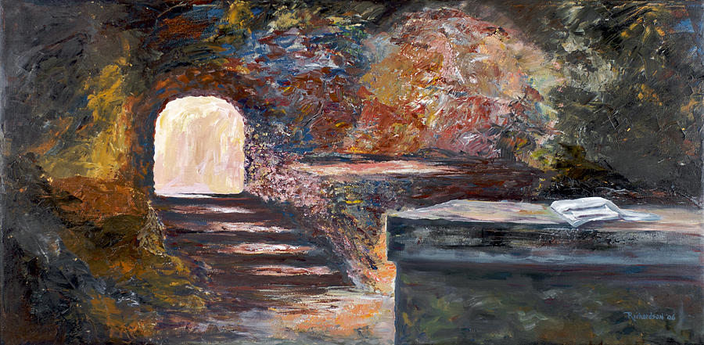
Legitimated By His RESURRECTION.

Slide 14
John 20:19-20 NIV78
…Jesus came and stood among them and said, “Peace be with you!” ²⁰ After he said this, he showed them his hands and side…

Slide 15
1 Corinthians 15:2-4 NIV
By this gospel you are saved… ³ Christ died for our sins according to the Scriptures, ⁴ That he was buried, that he was raised on the third day according to the Scriptures…

Slide 16
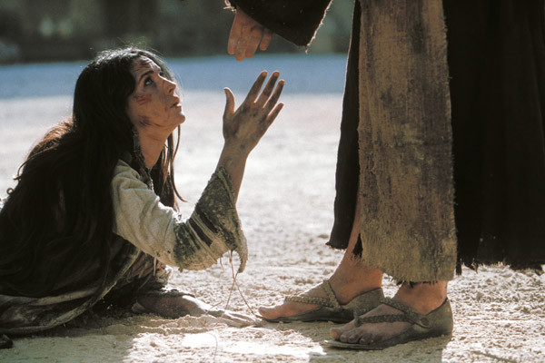
Motivated By His LOVE.

Slide 17
John 20:19 NIV78
…Jesus came and stood among them and said, “Peace be with you!”

Slide 18
John 3:16 KJV
For God so loved the world, that he gave his only begotten Son, that whosoever believeth in him should not perish, but have everlasting life.

Slide 19
The Great Love of Christ is…
INCARNATIONAL

Slide 20
John 15:19 NIV84
“As the Father has loved me, so have I loved you.”

Slide 21
The Great Love of Christ is…
INCARNATIONAL
RELATIONAL

Slide 22
1 John 1:3 NLT
…Our fellowship is with the Father and with his Son, Jesus Christ.

Slide 23
The Great Love of Christ is…
INCARNATIONAL
RELATIONAL
TRANSFORMATIONAL

Slide 24
John 13:34-35 NLT
“…Love each other. Just as I have loved you, you should love each other. ³⁵ Your love for one another will prove to the world that you are my disciples.”

Slide 25
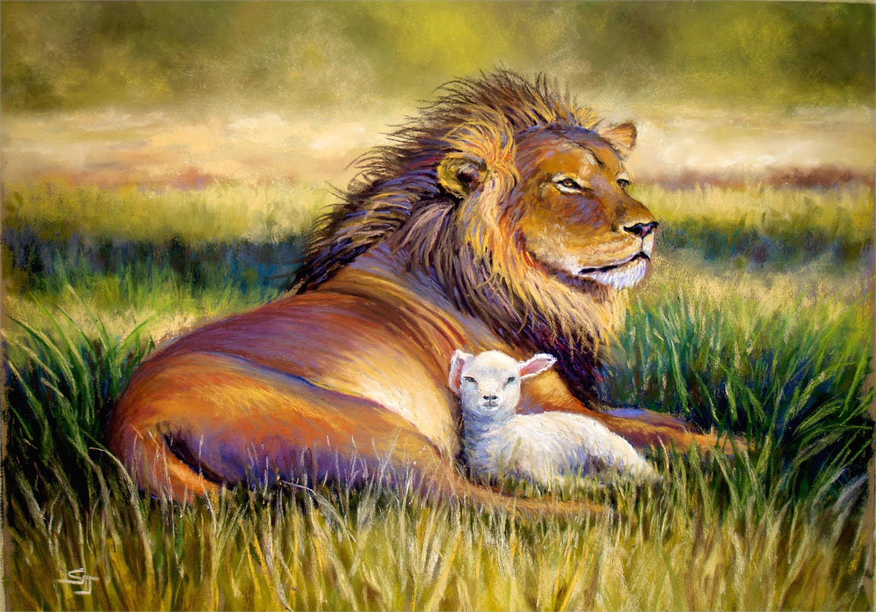
Captivated By His PEACE.

Slide 26
John 20:19 NIV78
…Jesus came and stood among them and said, “Peace be with you!”

Slide 27
He LOVES =
He LIVES +
Our PEACE.

Slide 28
1 Peter 5:7 AMP
Casting the whole of your care [all your anxieties, all your worries, all your concerns, once and for all] on Him, for He cares for you affectionately and cares about you watchfully.

Slide 29
Romans 14:17 VOICE
…The kingdom of God is not about eating and drinking. When God reigns, the order of the day is redeeming justice, true peace, and joy made possible by the Holy Spirit.

Slide 30
God’s WAY =
God’s WILL +
And We’ll Be OKAY!

Slide 31
Colossians 3:15 NKJV
…Let the peace of God rule in your hearts…

Slide 32
Peace is Our…
INHERITANCE

Slide 33
John 14:27 NIV
Peace I leave with you; my peace I give you…

Slide 34
Philippians 4:6 NKJV
Be anxious for nothing, but in everything by prayer and supplication, with thanksgiving, let your requests be made known to God;

Slide 35
Philippians 4:7 NKJV
And the peace of God, which surpasses all understanding, will guard your hearts and minds through Christ Jesus.

Slide 36
Peace is Our…
INHERITANCE
RESPONSIBILITY

Slide 37
Romans 15:13 NIV
May the God of hope fill you with all joy and peace as you trust in him, so that you may overflow with hope by the power of the Holy Spirit.

Slide 38
Matthew 5:9 NIV
Blessed are the peacemakers, for they will be called children of God.

Slide 39
Romans 12:18 NIV
…As far as it depends on you, live at peace with everyone.

Slide 40
1 Peter 3:8 NIV
Finally, all of you, live in harmony with one another; be sympathetic, love as brothers, be compassionate and humble.

Slide 41
1 Peter 3:9 NIV
Do not repay evil with evil or insult with insult, but with blessing, because to this you were called so that you may inherit a blessing.

Slide 42
Luke 6:27 AMP
“But I say to you who hear [Me and pay attention to My words]: Love [that is, unselfishly seek the best or higher good for] your enemies,[make it a practice to] do good to those who hate you...”

Slide 43
Luke 6:28 AMP
“Bless and show kindness to those who curse you, pray for those who mistreat you.”

Slide 44
2 Corinthians 5:18 NIV
All this is from God, who reconciled us to himself through Christ and gave us the ministry of reconciliation:

Slide 45
2 Corinthians 5:19 NIV
That God was reconciling the world to himself in Christ, not counting men’s sins against them. And he has committed to us the message of reconciliation.

Slide 46
1 John 1:9 VOICE
But if we own up to our sins, God shows that He is faithful and just by forgiving us of our sins and purifying us from the pollution of all the bad things we have done.

Slide 47
FORGIVENESS +

Slide 48
AGREEMENT =
FORGIVENESS +

Slide 49
AGREEMENT =
FORGIVENESS +
RECONCILIATION.

Slide 50
1 John 2:2 VOICE
It was through His sacrificial death that our sins were atoned. But He did not stop there—He died for the sins of the whole world.

Slide 51
Acts 9:26 VOICE
And he [Saul] returned to Jerusalem. He tried to join the disciples there, but they didn’t think he was sincere.

Slide 52
Acts 9:27a VOICE
Only one person accepted Saul as a genuine disciple, Barnabas, who became Saul’s advocate to the apostles…

Slide 53
Acts 9:27b VOICE
…He told the whole story of what happened in Damascus, from Saul’s vision and message from the Lord to his transformation into a confident proclaimer of the name of Jesus.

Slide 54
Romans 14:19 AMP
So then, let us pursue [with enthusiasm] the things which make for peace and the building up of one another [things which lead to spiritual growth].

Slide 55
Romans 10:15 NKJV
And how shall they preach unless they are sent? As it is written: “How beautiful are the feet of those who preach the gospel of peace, Who bring glad tidings of good things!”

Slide 56
Reconciliation within
Reconciliation within the BODY precedes
The COMMUNITY.

Slide 57
1 Corinthians 12:27 VOICE
You are the body of the Anointed, the Liberating King; each and every one of you is a vital member.

Slide 58
Peace is Our…
INHERITANCE
RESPONSIBILITY
LEGACY

Slide 59
INHERITANCE is what we RECEIVE.

Slide 60
INHERITANCE is what we RECEIVE.
RESPONSIBILITY is what we DO.

Slide 61
INHERITANCE is what we RECEIVE.
RESPONSIBILITY is what we DO.
LEGACY is what we LEAVE.

Slide 62
John Maxwell
“The Law of ‘Like begets Like’ tells us: We may teach what we know, but we reproduce what we are.”

Slide 63
James 3:18 NIV
Peacemakers who sow in peace raise a harvest of righteousness.

Slide 64
Harper’s Bible Dictionary…
“The Peacemakers are those who work for the wholeness and well-being that God wills for a broken world.”

Slide 65
Luke 6:35 NIV
But love your enemies, do good to them, and lend to them without expecting to get anything back. Then your reward will be great, and you will be sons of the Most High, because he is kind to the ungrateful and wicked.

Slide 66
2 Corinthians 4:3 NLT
If the Good News we preach is hidden behind a veil, it is hidden only from people who are perishing.

Slide 67
2 Corinthians 4:4a NLT
Satan, who is the god of this world, has blinded the minds of those who don’t believe. They are unable to see the glorious light of the Good News…

Slide 68
2 Corinthians 4:4b NLT
They don’t understand this message about the glory of Christ, who is the exact likeness of God.

Slide 69
2 Corinthians 4:5 NLT
You see, we don’t go around preaching about ourselves. We preach that Jesus Christ is Lord, and we ourselves are your servants for Jesus’ sake.

Slide 70
2 Corinthians 4:6 NLT
For God, who said, “Let there be light in the darkness,” has made this light shine in our hearts so we could know the glory of God that is seen in the face of Jesus Christ.

Slide 71
Ephesians 2:14 NIV
For He Himself is our Peace…

Slide 72
Ephesians 2:14 VOICE
He is the embodiment of our peace, sent once and for all to take down the great barrier of hatred and hostility that has divided us so that we can be one.

Slide 73
Matthew 5:9 AMPC
Blessed (enjoying enviable happiness, spiritually prosperous—with life-joy and satisfaction in God’s favor and salvation, regardless of their outward conditions) are the makers and maintainers of peace, for they shall be called the sons of God!

Slide 74
The Prayer of Francis of Assisi
“Lord, make me an instrument of your peace: where there is hatred, let me sow love; where there is doubt, faith;”

Slide 75
The Prayer of Francis of Assisi
“where there is despair, hope; where there is darkness, light; where there is sadness, joy.”

Slide 76
The Prayer of Francis of Assisi
“O Divine Master, grant that I may not so much seek to be consoled as to console, to be understood as to understand,”

Slide 77
The Prayer of Francis of Assisi
“to be loved as to love. For it is in giving that we receive, it is in pardoning that we are pardoned,”

Slide 78
The Prayer of Francis of Assisi
“and it is in dying that we are born to eternal life. Amen.”

Slide 79
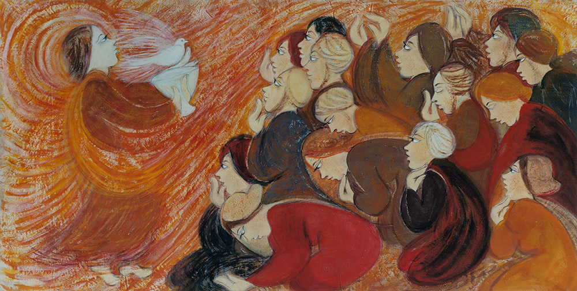
Empowered By His BREATH.

Slide 80
John 20:21-22 NIV78
Again Jesus said, “Peace be with you! As the Father has sent me, I am sending you.” ²² And with that he breathed on them and said, “Receive the Holy Spirit.”

Slide 81
Habakkuk 3:2 MESSAGE
God, I’ve heard what our ancestors say about you, and I’m stopped in my tracks, down on my knees. Do among us what you did among them. Work among us as you worked among them…

