Slide 1
How MUCH
Much Do
You Love God?
Dr. Hannah Harrington
Christian Cathedral
February 21, 2016

Slide 2


Slide 3
WHY DO WE LOVE GOD?
DO WE ONLY LOVE HIM FOR SUPERFICIAL REASONS.
  LOOKING FOR MATERIAL BLESSINGS
  GOOD ETHICS FOR FAMILY
  SECURITY FOR AFTERLIFE

Slide 4
WHAT HAPPENS WHEN THE LOVING GOD ALLOWS US TO SUFFER?
IF OUR LOVE IS BASED SIMPLY ON GOD’S GOODNESS TO US, THEN IT WILL BE CALLED INTO QUESTION WHEN WE HAVE DIFFICULTIES.

Slide 5
Job 1:1-2
There was a man in the land of Uz whose name was Job; and that man was blameless, upright, fearing God and turning away from evil. Seven sons and three daughters were born to him. His possessions also were 7,000 sheep, 3,000 camels, 500 yoke of oxen, 500 female donkeys, and very many servants; and that man was the greatest of all the men of the east.

Slide 6
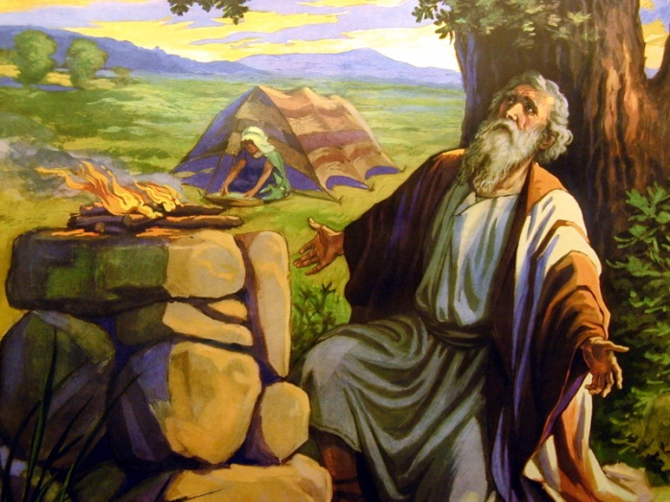
Job 1:3-5
His sons used to go and hold a
feast in the house of each one on his set day, and they would send and invite their three sisters to eat and drink with them. [Job would sacrifice offerings for them to God] for Job said, "Perhaps my sons have sinned and cursed God in their hearts." Thus Job did continually.…

Slide 7
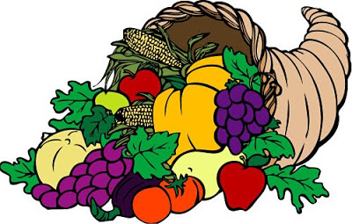
Job had a very good Life
Close Relationship with God – Righteous
Wealth
Servants
10 Kids
Close Family Relationships
Prayer in the Home

Slide 8
THE CHALLENGING QUESTION:
“Does Job fear God for nothing?” Satan replied. “Have you not put a hedge around him and his household and everything he has? You have blessed the work of his hands, so that his flocks and herds are spread throughout the land. ¹¹ But now stretch out your hand and strike everything he has, and he will surely curse you to your face.” (Job 1:9-11 NIV)

Slide 9
Job 1:13-17 LOSS OF WEALTH
A VERY BAD DAY…
Sabeans attacked and stole oxen and donkeys and killed servants
Fire fell from heaven and burned up sheep and servants
Chaldeans stole his camels and killed servants

Slide 10

Job 1:18-19 Loss of family
“…a great wind came from across the wilderness and struck the four corners of the house, and it fell on the young people and they died, and I alone have escaped to tell you."

Slide 11
Job’s response
Then Job arose and tore his robe and shaved his head, and he fell to the ground and worshiped.…(Job 1:20)
He said, "Naked I came from my mother's womb, And naked I shall return there. The LORD gave and the LORD has taken away. Blessed be the name of the LORD.“(Job 1:21)
Through all this Job did not sin nor did he blame God. (Job 1:22)

Slide 12
ANOTHER VERY BAD DAY—DISEASE
Satan answered the LORD and said, "Skin for skin! Yes, all that a man has he will give for his life."However, put forth Your hand now, and touch his bone and his flesh; he will curse You to Your face” (Job 2:4-5).
So the LORD said to Satan, "Behold, he is in your power, only spare his life." Then Satan went out from the presence of the LORD and smote Job with sore boils from the sole of his foot to the crown of his head. (Job 2:6-7)

Slide 13
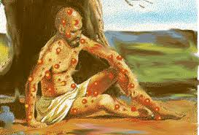
Job’s response
Took care of himself the best he could

Slide 14
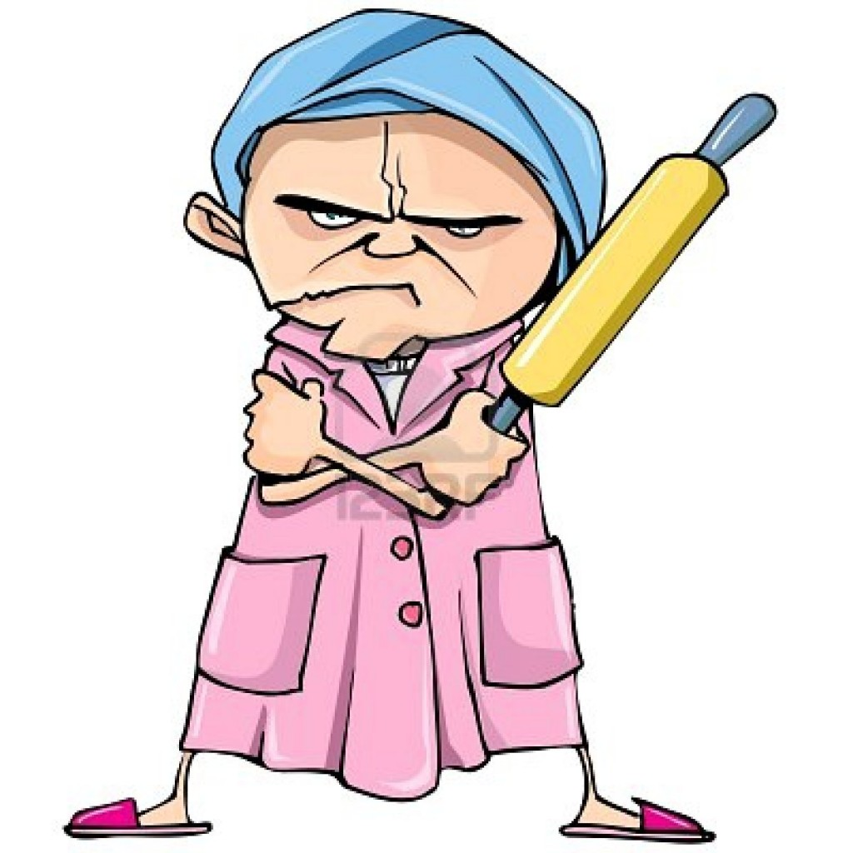
DIFFICULT PEOPLE
“You still keep your integrity! Curse God and die!”
JOB’S WIFE

Slide 15

Job’s response
“Shall we accept good from God and not
trouble?”
(Job 2:10b).

Slide 16

“Now when Job's three friends heard of all this adversity… they made an appointment together to come to sympathize with him and comfort him” (Job 2:11-13).
They mourned with him 7 days

Slide 17
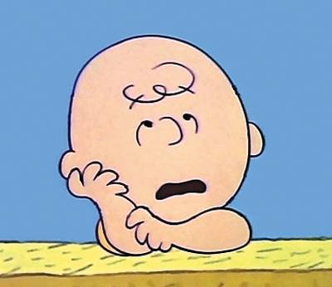
Difficult friends
Eliphaz: "Consider now: Where
were the upright ever destroyed?”(4:7).
Bildad: "Does God pervert justice?”(8:3).
Zophar: "Yet if you devote your heart to [the LORD] and stretch out your hands to him, if you will put away the sin that is in your hand and allow no evil to dwell in your tent, then you will lift up your face without shame … But the eyes of the wicked will fail … Their hope will become a dying gasp" (Job 11: 13-20).

Slide 18


Job’s response
Defended himself: “You invent lies; All of you are quacks!” (Job 13:4).
Pursued God: “Oh, that I knew how to reach Him” (Job 23:3). “Why do you hide your face?” (13:24b).
Trusted God: “Though he slay me, yet will I trust Him” (Job 13:15).

Slide 19
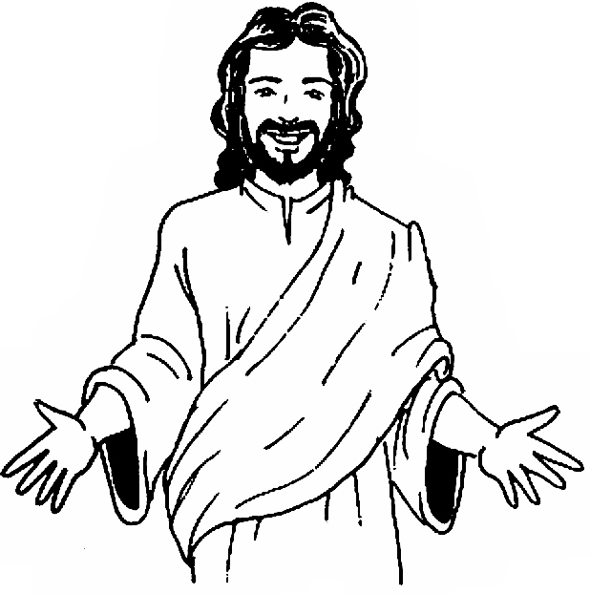
PROPHETIC
INSPIRATION
“I know that my
Redeemer lives, and
that in the end he will
stand on the earth.
And after my skin has
been destroyed,yet in
my flesh I will see God; I myself will see him with my own eyes—I, and not another. How my heart yearns within me! (Job 19:25-27)

Slide 20
HOW TO STRENGTHEN YOUR LOVE FOR GOD: Embrace the Person of Jesus
Commit yourself to Him – Serve Him
Grow in love – don’t be satisfied with less
Endure difficulties together – pursue and worship Him

